Slide 1

DESIGN AND ANALYSIS OF ALGORITHMS (113939)
Dr. Owais Hussain

Slide 2

Agenda
Divide and Conquer Strategy
Merge Sort
Exercise
Complexity Analysis
Map-Reduce
Quicksort
Exercise
Complexity Analysis

Slide 3
Sample 2
Divide and Conquer Strategy
This strategy has been successfully deployed in military campaigns, for example, by Roman empire (Julius Caesar’s conquest of France) and by British colonizers to conquer and rule over India.
In mathematics and computing, Divide and Conquer follows this rule by splitting a larger problem into many sub-problems to make them easier to solve.
Divide and Conquer does not necessarily mean solving through recursion. Any algorithm, which breaks the problem and solves them is divide and conquer.
Parallel and Distributed computing is also an example of Divide and Conquer.

Slide 4
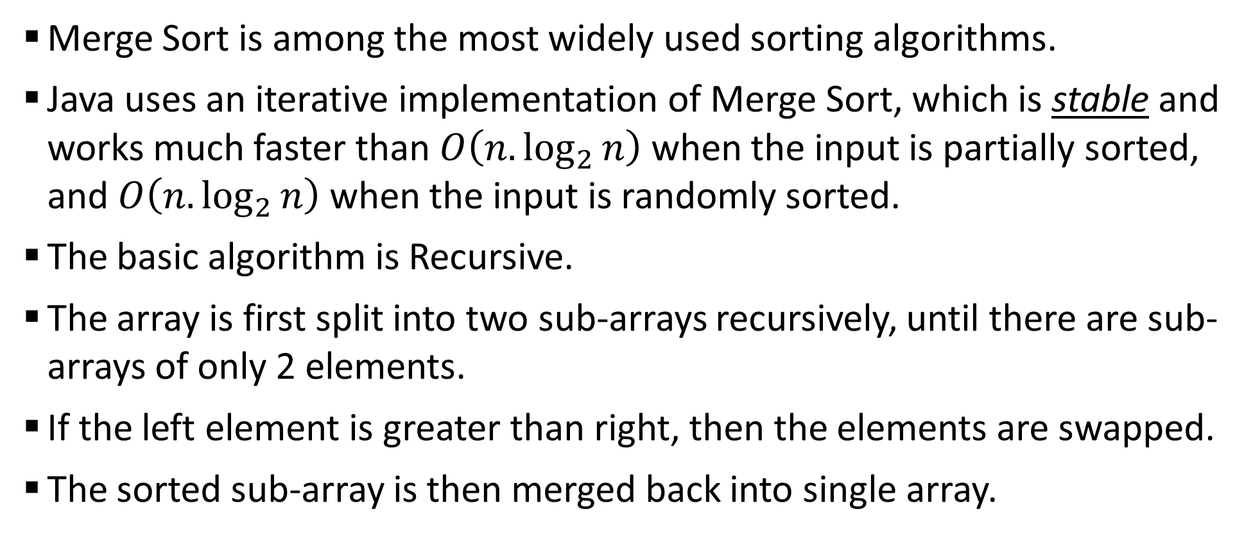
Sample 2
Merge Sort
Merge Sort is among the most widely used sorting algorithms.
Java uses an iterative implementation of Merge Sort, which is stable and works much faster than $O\left(n.\log_{2}{n}\right)$ when the input is partially sorted, and $O\left(n.\log_{2}{n}\right)$ when the input is randomly sorted.
The basic algorithm is Recursive.
The array is first split into two sub-arrays recursively, until there are sub-arrays of only 2 elements.
If the left element is greater than right, then the elements are swapped.
The sorted sub-array is then merged back into single array.
Notes:
A stable sort algorithm keeps the order intact. Meaning the ‘A’ at index 1 in “BACADGBTA” is not the same as ‘A’ at index 3.

Slide 5
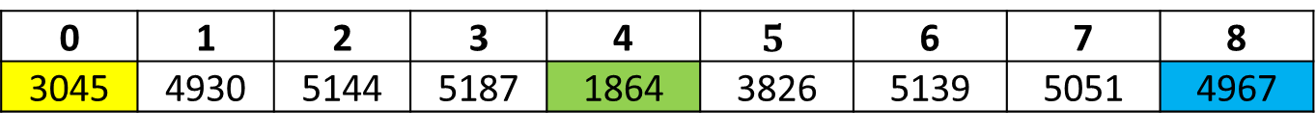
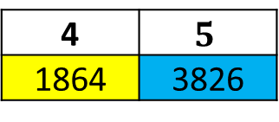
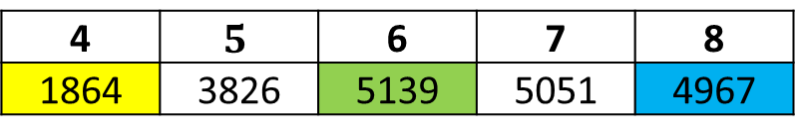
Sample 2
Merge Sort
0 | 1 | 2 | 3 | 4 | $$5$$ | 6 | 7 | 8
3045 | 4930 | 5144 | 5187 | 1864 | 3826 | 5139 | 5051 | 4967
0 | 1 | 2 | 3
3045 | 4930 | 5144 | 5187
4 | $$5$$ | 6 | 7 | 8
1864 | 3826 | 5139 | 5051 | 4967
0 | 1
3045 | 4930
2 | 3
5144 | 5187
4 | $$5$$
1864 | 3826
6 | 7 | 8
5139 | 5051 | 4967
0
3045
1
4930
2
5144
3
5187
4
1864
5
3826
6
5139
7 | 8
5051 | 4967
The splitting is like Binary search. Yellow represents min value; Green is the mid position and Blue represents max value.
7
5051
8
4967

Slide 6
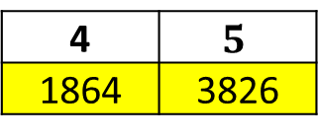
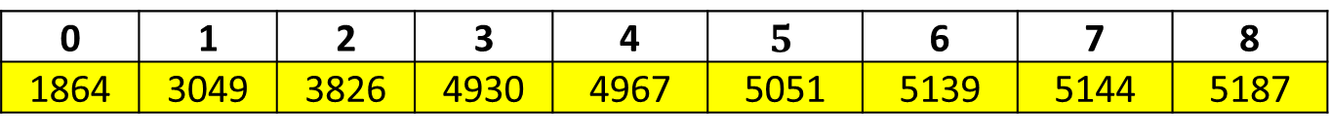
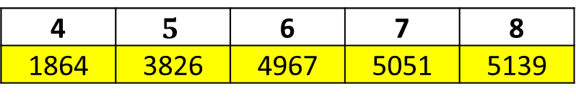
Sample 2
Merge Sort
7
5051
8
4967
0
3045
1
4930
2
5144
3
5187
4
1864
5
3826
6
5139
7 | 8
4967 | 5051
0 | 1
3045 | 4930
2 | 3
5144 | 5187
4 | $$5$$
1864 | 3826
6 | 7 | 8
4967 | 5051 | 5139
0 | 1 | 2 | 3
3049 | 4930 | 5144 | 5187
4 | $$5$$ | 6 | 7 | 8
1864 | 3826 | 4967 | 5051 | 5139
0 | 1 | 2 | 3 | 4 | $$5$$ | 6 | 7 | 8
1864 | 3049 | 3826 | 4930 | 4967 | 5051 | 5139 | 5144 | 5187
Note that the sub-arrays are merged in sorted order. But since each sub-array is sorted itself, therefore there’s no need for nested arrays in implementation.

Slide 7
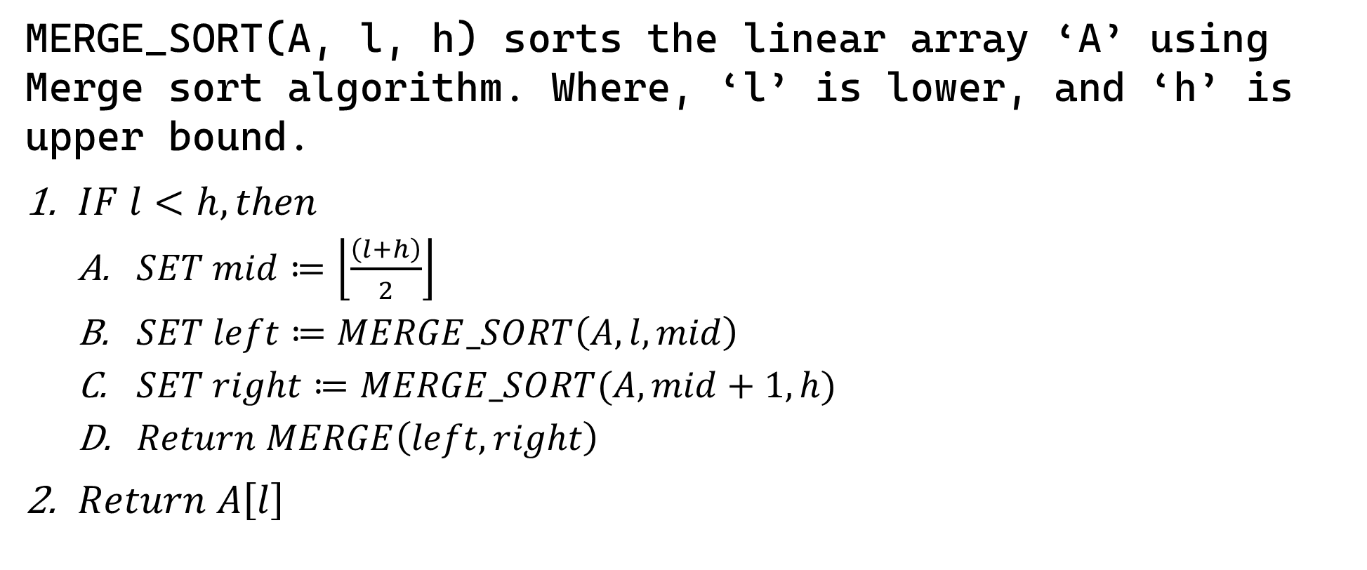
Sample 2
Merge Sort
MERGE_SORT(A, l, h) sorts the linear array ‘A’ using Merge sort algorithm. Where, ‘l’ is lower, and ‘h’ is upper bound.
$IF l<h, then$
$SET mid≔\left\lfloor \frac{\left(l+h\right)}{2}\right\rfloor$
$SET left≔MERGE_SORT\left(A, l,mid\right)$
$SET right≔MERGE_SORT(A,mid+1,h)$
$Return MERGE\left(left, right\right)$
$Return A\left[l\right]$

Slide 8
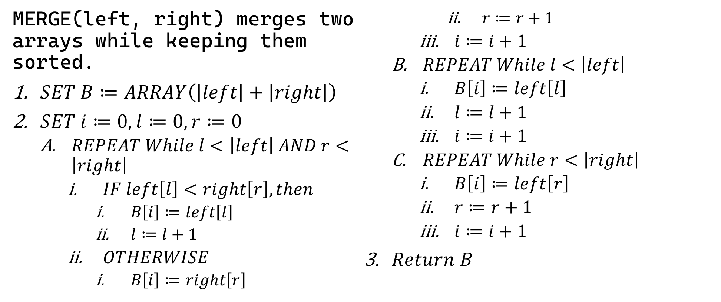
Sample 2
Merge Sort
MERGE(left, right) merges two arrays while keeping them sorted.
$SET B≔ARRAY\left(\left|left\right|+\left|right\right|\right)$
$SET i≔0, l≔0, r≔0$
$REPEAT While l<\left|left\right| AND r<\left|right\right|$
$IF left\left[l\right]<right\left[r\right], then$
$B\left[i\right]≔left\left[l\right]$
$l≔l+1$
$OTHERWISE$
$B\left[i\right]≔right\left[r\right]$
$r≔r+1$
$i≔i+1$
$REPEAT While l<\left|left\right|$
$B\left[i\right]≔left\left[l\right]$
$l≔l+1$
$i≔i+1$
$REPEAT While r<\left|right\right|$
$B\left[i\right]≔left\left[r\right]$
$r≔r+1$
$i≔i+1$
$Return B$

Slide 9
Sample 2
Exercise
Write your Mobile phone number with country code. (like 00923453174270)
Consider it as an array of integers and show how Merge sort will sort this number in ascending order.

Slide 10
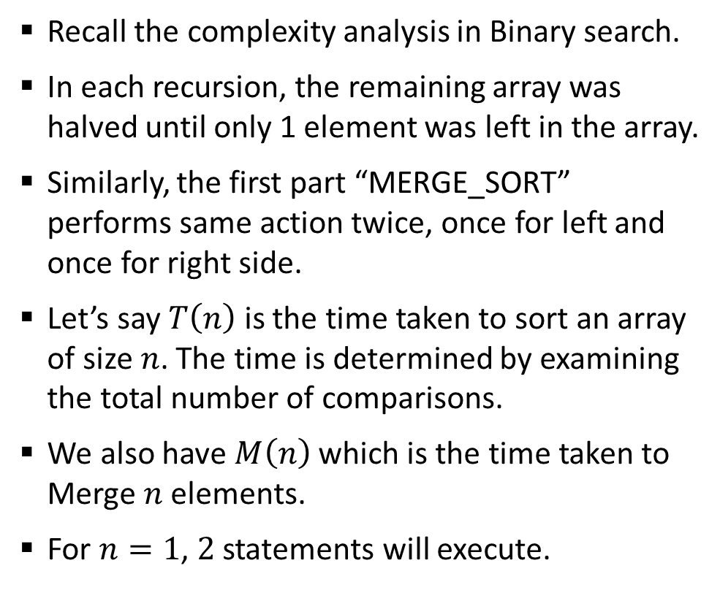
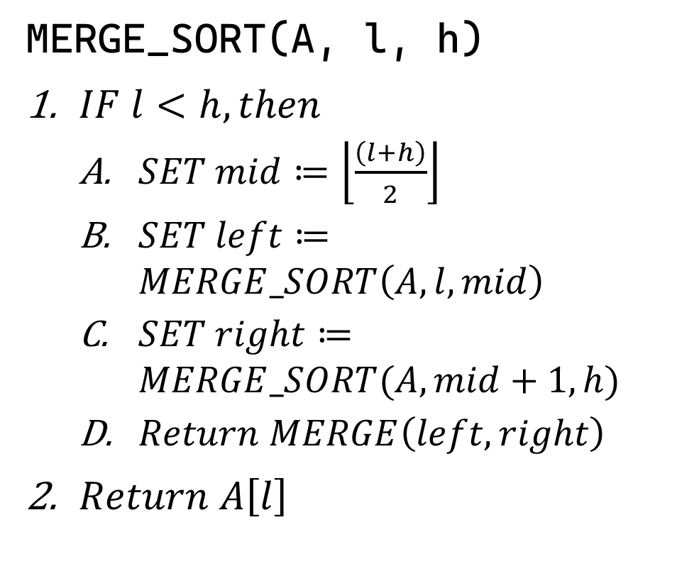
Sample 2
Complexity Analysis of Merge Sort
Recall the complexity analysis in Binary search.
In each recursion, the remaining array was halved until only 1 element was left in the array.
Similarly, the first part “MERGE_SORT” performs same action twice, once for left and once for right side.
Let’s say $T\left(n\right)$ is the time taken to sort an array of size $n$. The time is determined by examining the total number of comparisons.
We also have $M\left(n\right)$ which is the time taken to Merge $n$ elements.
For $n=1$, $2$ statements will execute.
MERGE_SORT(A, l, h)
$IF l<h, then$
$SET mid≔\left\lfloor \frac{\left(l+h\right)}{2}\right\rfloor$
$SET left≔MERGE_SORT\left(A, l,mid\right)$
$SET right≔MERGE_SORT(A,mid+1,h)$
$Return MERGE\left(left, right\right)$
$Return A\left[l\right]$

Slide 11
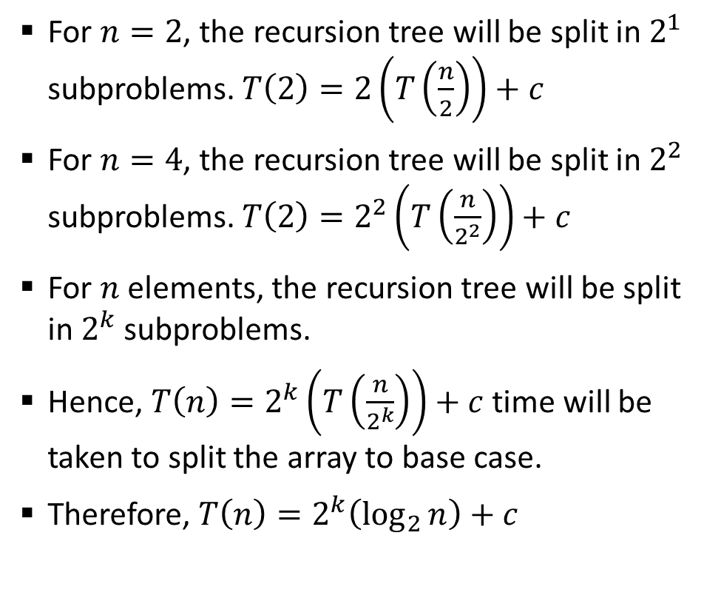
Sample 2
Complexity Analysis of Merge Sort
For $n=2$, the recursion tree will be split in $2^{1}$ subproblems. $T\left(2\right)=2\left(T\left(\frac{n}{2}\right)\right)+c$
For $n=4$, the recursion tree will be split in $2^{2}$ subproblems. $T\left(2\right)=2^{2}\left(T\left(\frac{n}{2^{2}}\right)\right)+c$
For $n$ elements, the recursion tree will be split in $2^{k}$ subproblems.
Hence, $T\left(n\right)=2^{k}\left(T\left(\frac{n}{2^{k}}\right)\right)+c$ time will be taken to split the array to base case.
Therefore, $T\left(n\right)=2^{k}\left(\log_{2}{n}\right)+c$
n
n/2
n/2
n
n/2
n/2
n/4
n/4
n/4
n/4

Slide 12
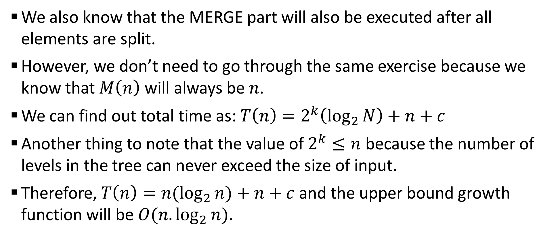
Sample 2
Complexity Analysis of Merge Sort
We also know that the MERGE part will also be executed after all elements are split.
However, we don’t need to go through the same exercise because we know that $M\left(n\right)$ will always be $n$.
We can find out total time as: $T\left(n\right)=2^{k}\left(\log_{2}{N}\right)+n+c$
Another thing to note that the value of $2^{k}≤n$ because the number of levels in the tree can never exceed the size of input.
Therefore, $T\left(n\right)=n(\log_{2}{n)+n+c}$ and the upper bound growth function will be $O(n.\log_{2}{n)}$.

Slide 13
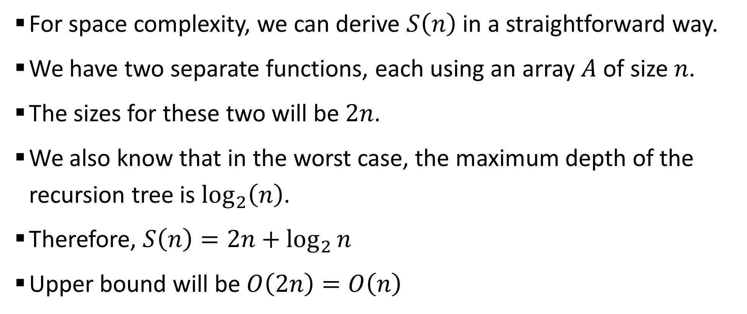
Sample 2
Complexity Analysis of Merge Sort
For space complexity, we can derive $S\left(n\right)$ in a straightforward way.
We have two separate functions, each using an array $A$ of size $n$.
The sizes for these two will be $2n$.
We also know that in the worst case, the maximum depth of the recursion tree is $\log_{2}\left(n\right)$.
Therefore, $S\left(n\right)=2n+\log_{2}{n}$
Upper bound will be $O\left(2n\right)=O\left(n\right)$

Slide 14
Sample 2
Map-Reduce
Map-Reduce is a programming paradigm used by Hadoop framework for parallel processing of Big data.
Hadoop is an open-source framework made after reverse engineering Google’s cloud. It uses clusters of computers to solve Big data problems that cannot be solved using a single computer.
Map-reduce is a prime example of Divide and Conquer in which a large dataset is split into batches by a master node using a “Map” function
Each batch is served to worker nodes to work on it and return results.
The results are collected using another function called “Reduce”.

Slide 15
Sample 2
Map-Reduce – A Practical Example
Can you use Map-Reduce to find out frequency of each word in the Novel “Lord of the Rings” (all 3 books)?
One way is to create a loop and read the files one by one. Maintain a dictionary and update the frequency of each word.
The Map-Reduce approach will be to create 3 processes, one for each book. Each process will maintain a table of word as key and frequency as value.
The Reduce function will combine the results from all 3 processes.

Slide 16
Sample 2
Analysis of Selection Sort
DEMO

Slide 17
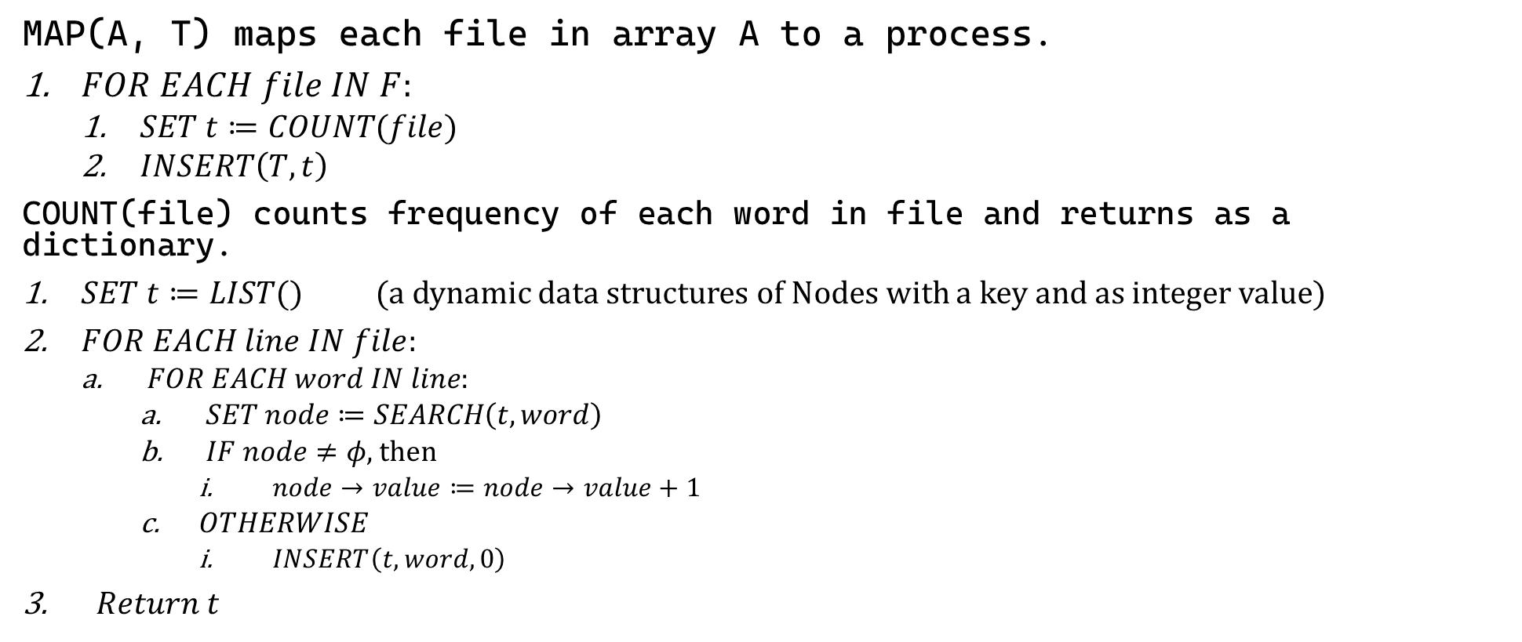
Sample 2
Map-Reduce – A Practical Example
MAP(A, T) maps each file in array A to a process.
$FOR EACH file IN F$:
$SET t≔COUNT(file)$
$INSERT\left(T,t\right)$
COUNT(file) counts frequency of each word in file and returns as a dictionary.
$SET t≔LIST()$ (a dynamic data structures of Nodes with a key and as integer value)
$FOR EACH line IN file$:
$FOR EACH word IN line:$
$SET node≔SEARCH\left(t, word\right)$
$IF node≠φ$, then
$node→value≔node→value+1$
$OTHERWISE$
$INSERT\left(t, word, 0\right)$
$Return t$

Slide 18
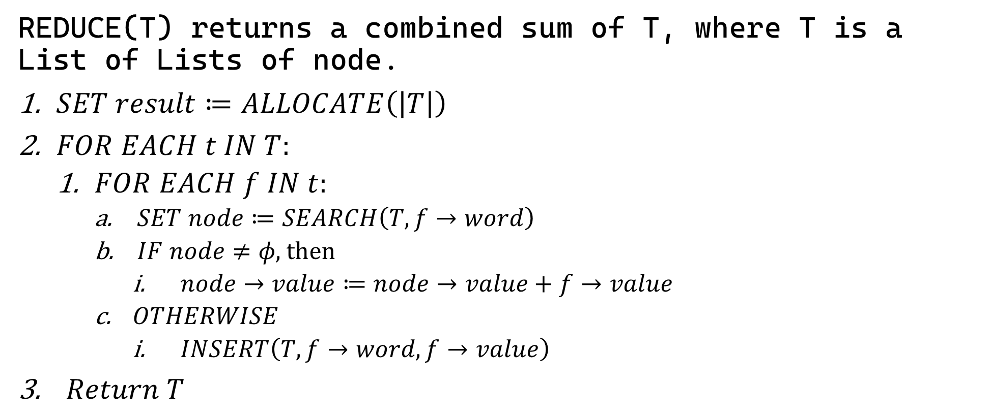
Sample 2
Map-Reduce – A Practical Example
REDUCE(T) returns a combined sum of T, where T is a List of Lists of node.
$SET result≔ALLOCATE\left(\left|T\right|\right)$
$FOR EACH t IN T:$
$FOR EACH f IN t$:
$SET node≔SEARCH\left(T,f→word\right)$
$IF node≠φ\text{, }\text{then}$
$node→value≔node→value+f→value$
$OTHERWISE$
$INSERT\left(T, f→word, f→value\right)$
$Return T$

Slide 19
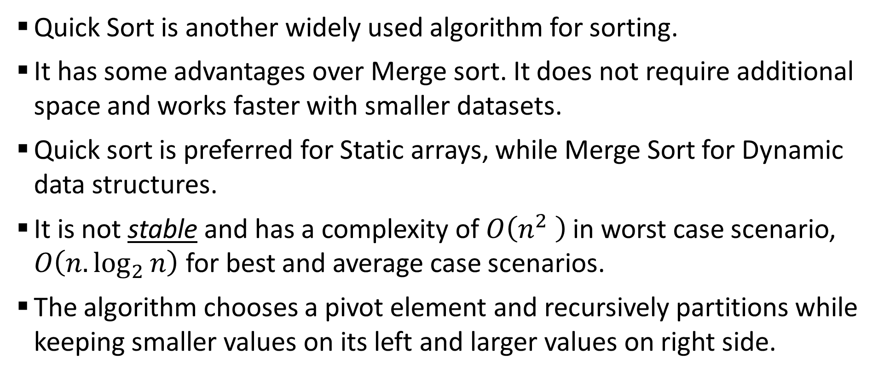
Sample 2
Quick Sort
Quick Sort is another widely used algorithm for sorting.
It has some advantages over Merge sort. It does not require additional space and works faster with smaller datasets.
Quick sort is preferred for Static arrays, while Merge Sort for Dynamic data structures.
It is not stable and has a complexity of $O\left(n^{2} \right)$ in worst case scenario, $O\left(n.\log_{2}{n}\right)$ for best and average case scenarios.
The algorithm chooses a pivot element and recursively partitions while keeping smaller values on its left and larger values on right side.

Slide 20
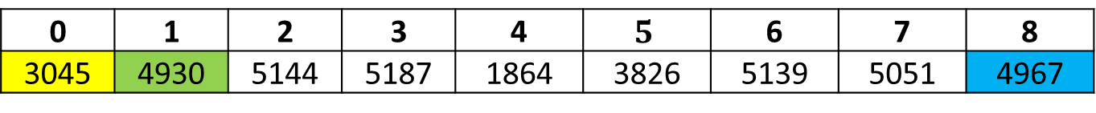
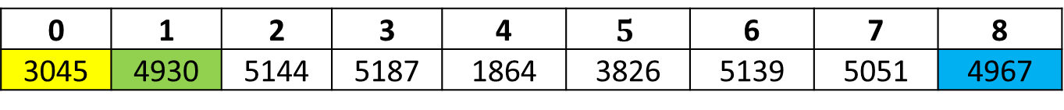
Sample 2
Quick Sort
0 | 1 | 2 | 3 | 4 | $$5$$ | 6 | 7 | 8
3045 | 4930 | 5144 | 5187 | 1864 | 3826 | 5139 | 5051 | 4967
0 | 1 | 2 | 3 | 4 | $$5$$ | 6 | 7 | 8
3045 | 4930 | 5144 | 5187 | 1864 | 3826 | 5139 | 5051 | 4967

Slide 21



THANK YOU
Owais Hussain
+92 345-3174270
owais.hussain@kiet.edu.pk
https://www.researchgate.net/profile/Owais-Hussain-3

